Slide 1


Covidence for Systematic Reviews:
Essentials
Sharon Duffy, MLIS
Research Services Librarian
Systematic Review Librarian
sduffy@lsuhsc.edu
Rowan Marye, MLIS
Public Services Librarian
Systematic Review Librarian
rmarye@lsuhsc.edu

Slide 2
Objectives
What is Covidence?
Setting up a review
Performing a Review
  Importing references
  Title and Abstract Screening
  Full-Text Screening
  Introduction to Data Extraction
  Introduction to Risk of Bias/Quality Assessment
Exports and Outputs
Best practices and tips for success
Covidence Resources

Slide 3
What is covidence?

Slide 4
Covidence is:
Cloud based software
Nothing to install or download
Designed to streamline and organize review projects
Works for systematic, scoping, other literature reviews
Gather full-text PDFs
Create PRISMA flow diagram

Slide 5

Where covidence fits in the review project workflow
Research question
Librarian consult
Search multiple databases
Title & Abstract Screen
Data Extraction
Quality assessment
Full Text Screen
Analysis
Synthesis
Publish

Slide 6
What covidence is NOT:
A reference manager
A database
A search engine
A place to search for studies
A place to perform meta-analysis

Slide 7
Accessing covidence
Institutional subscription through Libraries
Unlimited reviews
Allows multi-institution collaborators
Email reference@lsuhsc.edu to request access
Receive invitation to join Covidence
Faculty, Residents, Graduate students added as Members
  Can create additional reviews
Students added as reviewers to project
  Have full access and privileges on review

Slide 8
Setting Up a review

Slide 9
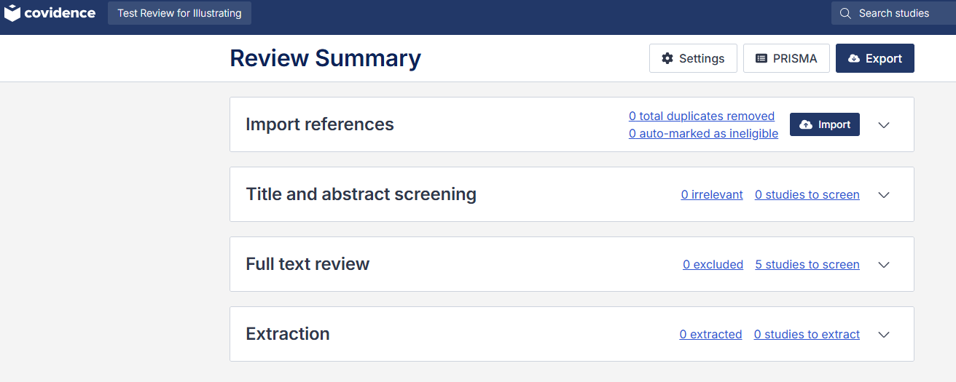
Creating a review & Project Dashboard
Live Demo in Covidence
View Test Review

Slide 10
Automation options in settings
Screening phase:
Tag references for RCTs
Remove non-RCTs
Only for Medical & Health Sciences
Integrates Cochrane RCT Classifier
Extraction phase:
Only available for reviews collecting numerical data; not scoping/qualitative reviews
Limited to study characteristic fields: First Author name, Address, Institution, Country, Email, Sponsorship source
Human review always available for automated steps.

Slide 11
Review settings and Extraction Tool
Customize number of reviewers
  Two is default
  Two is recommended
  Add unlimited reviewers from multiple institutions
Choose Extraction Tool
Extraction 1
  Default for Systematic Review
  Best for collecting structured data
  Has automatic extraction feature
Extraction 2
  Default for Scoping Review
  Fully customizable to collect narrative data and evidence mapping

Slide 12
Team Settings
Review contributions of team members at each phase
Set Rules for each reviewer
  Default is Everyone can do anything
  Could specify a person to resolve conflicts

Slide 13
Eligibility Criteria
Keep team on track:
PICO information
Study types
Exclusion criteria
Can display while screening to increase consistency
Highlight Terms:
Enter words/phrases
Inclusion will be highlighted in green
Exclusion will be highlighted in red
Full-Text Exclusion Reasons:
Default list available
Fully customizable
Standardize options for team
These tools are designed to speed up the screening process and increase consistency between reviewers.
They are optional and not required to perform a review.

Slide 14
Study Tags
Used to identify and filter studies
Add during screening steps
Default tags: Awaiting Classification & Ongoing study; cannot be deleted
Examples to add: Background reading, French, Spanish, Translation needed, RCT, Review article
Optional tool

Slide 15
Any Questions?

Slide 16
Let’s get started!

Slide 17
Importing references
No limit to number of reference that can be imported
File size limit of 15,000 references per batch; can import as many batches as needed
Multiple formats accepted in Covidence:
EndNote XML format
PubMed format
RIS format (from all other databases and citation managers)
PubMed demo
Save results
Select: All results
Format: PubMed
Create and download file

Slide 18
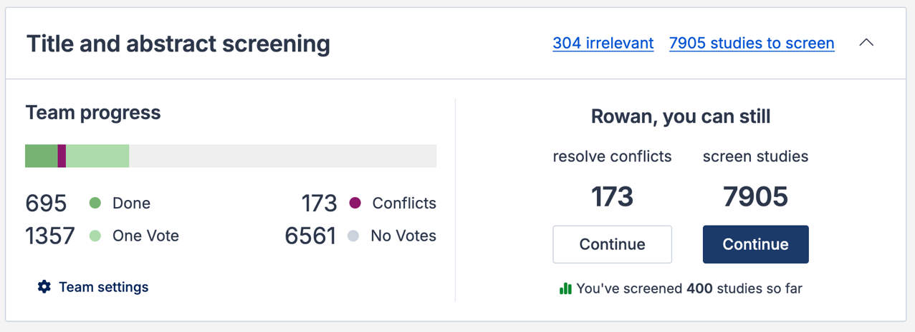
Title and abstract screening: The basics
The Review Summary Page will display an overview of the teams’ progress.

Slide 19
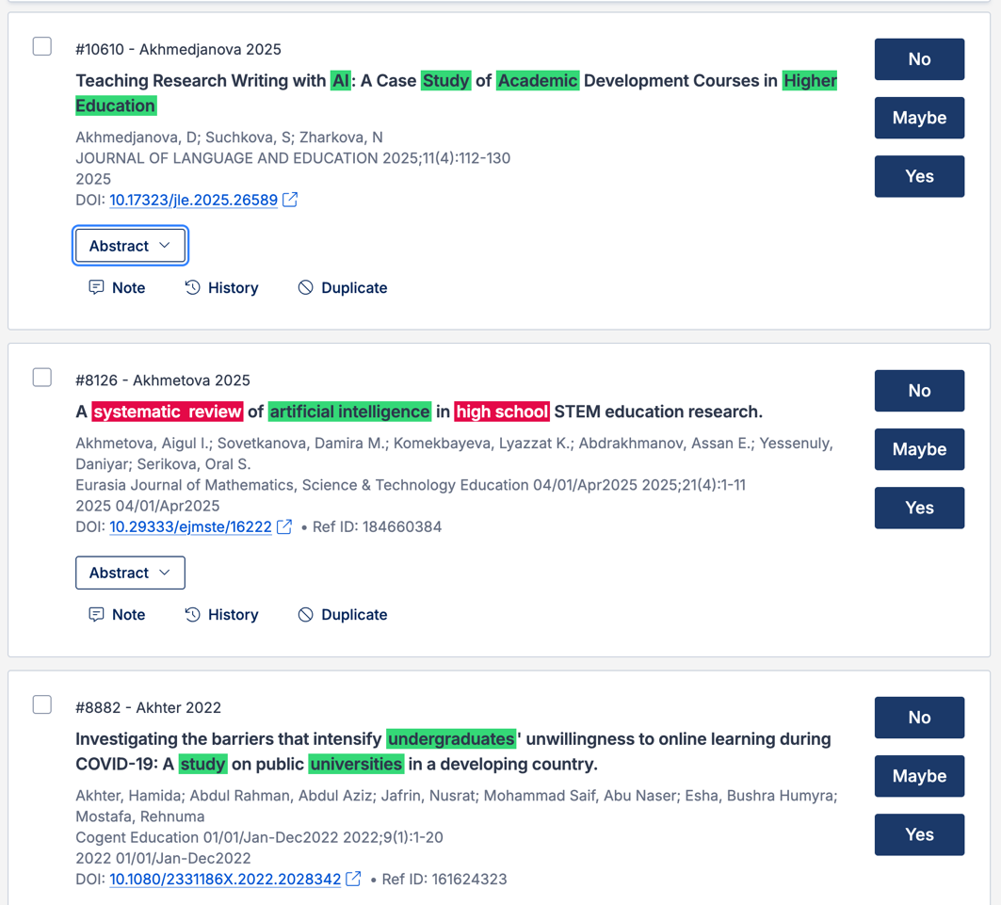
Title and abstract screening
Reviewers have the option to toggle Highlights On/Off and to hide/display the Abstracts.
Screening options are Yes, No, and Maybe, but there are also options to add notes or to remove items as duplicates if the automatic process missed a duplicate.

Slide 20
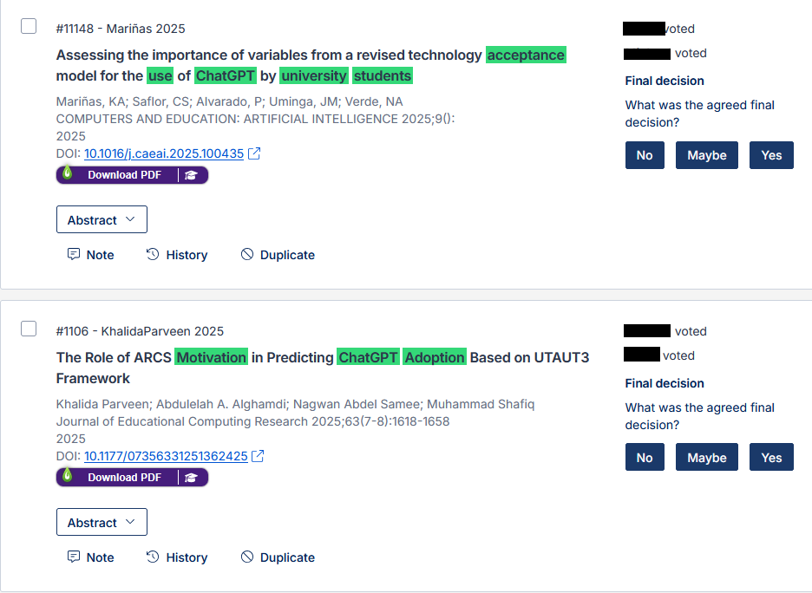
Managing screening conflicts
If two reviewers differ on whether a record should be included, that record will appear under ”Resolve Conflicts.”
Teams should make a plan for resolving these conflicts in advance.

Slide 21
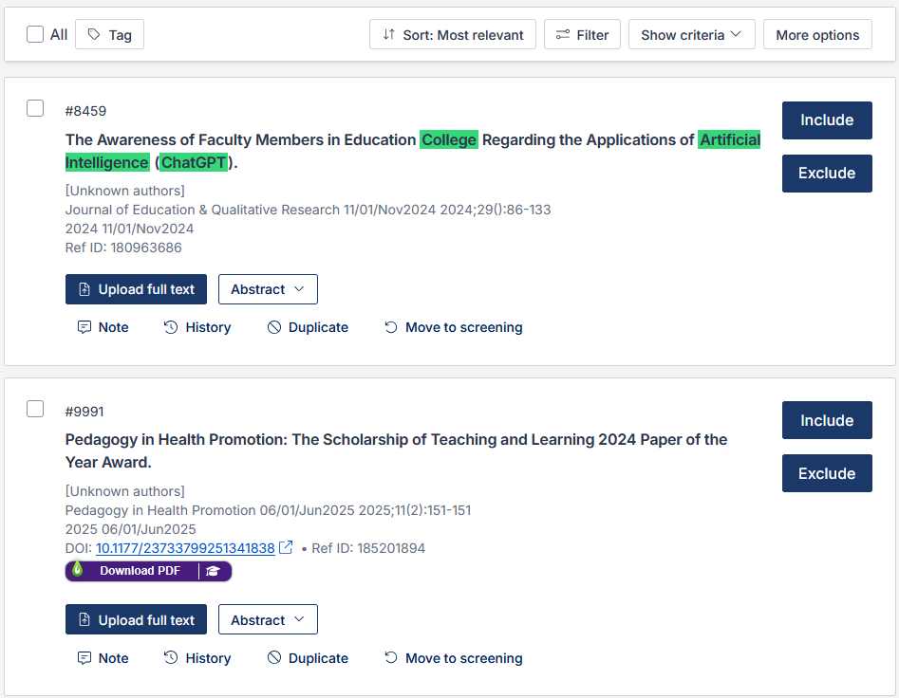
Full-Text screening
Similar process to the Title/Abstract stage, except that options are limited to Include/Exclude.
Also allows upload of full article text.
Again, you will have options to mark duplicates, add notes, or move items back to the previous screening stage.

Slide 22
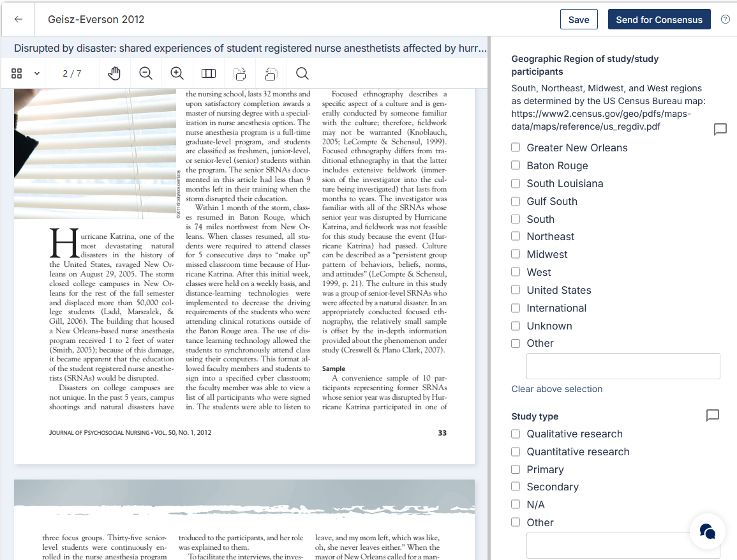
Introduction to Data Extraction
Create and customize your Data Extraction Template:
Extraction 1:
Best for collecting structured data.
Designed for use in quantitative synthesis or meta-analysis.
Extraction 2:
Fully customizable template for reviews that require more flexible field structures, such as descriptive, exploratory, or qualitative reviews.

Slide 23
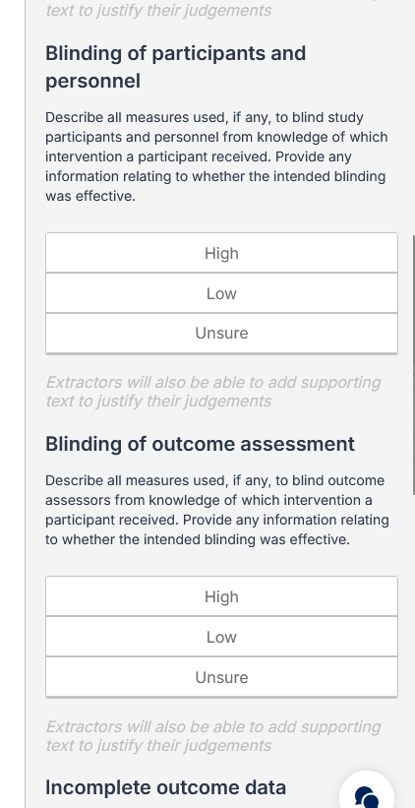
Risk of Bias and Quality Assessment
Covidence can also help with Risk of Bias and Quality Assessment.
The default Quality Assessment template is Cochrane’s Risk of Bias, but users have the option to use a different tool by creating their own template.

Slide 24
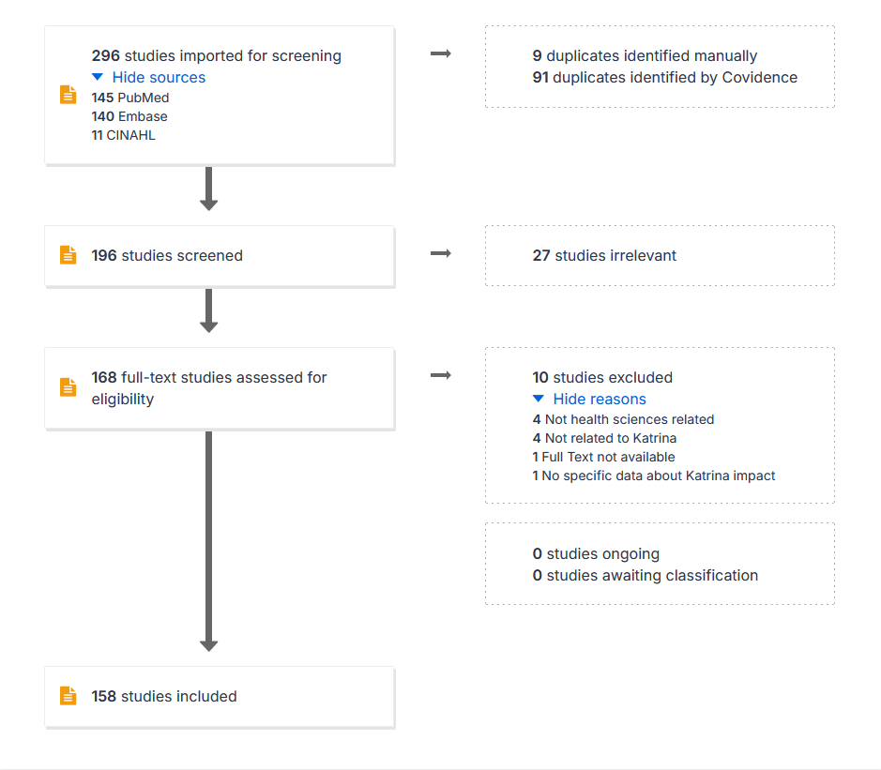
Exports, outputs & documentation
Covidence allows you to export the following types of data:
References
  Can generate reference lists for various sets of records
  Formats include common citation managers
Inter-rater reliability
  Measures consistency and agreement between reviewers
  Exports as CSV
Extraction
  Can extract both Data Extraction and Quality Assessment
  Can include both consensus and individual data
  Exports as CSV
PRISMA flowchart

Slide 25
Best Practices and Tips for Success
Register a protocol prior before starting the review
Take time with setting up the review prior to starting the screening steps
Conduct a pilot review to test screening criteria and data extraction template
Check in with your team early during both screening and extraction
Install LibKey Nomad browser extension to quickly locate and add full-text articles

Slide 26
Covidence Resources
Knowledge Base
  Videos and explanations
  Search or browse
eBooks
  Understanding Review Types in Research
  Protocol Development for Scoping Reviews
  A Practical Guide: Protocol Development for Systematic Reviews
  A Practical Guide: Screening for Systematic Reviews
  A Practical Guide: Data Extraction for Intervention Systematic Reviews

Slide 27
Questions and Comments

Slide 28
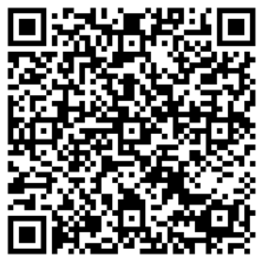

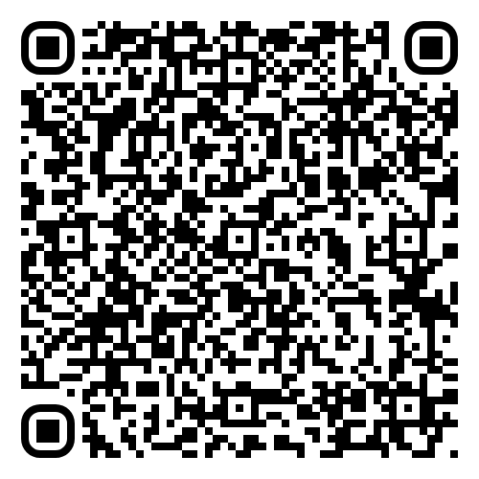
Connect with us!
Survey (Very short!)
Help us collect metrics!
Survey (Very short!)
Help us collect metrics!
Follow us on Instagram!
Sign up for Library Emails!
Sharon Duffy, MLIS
Research Services Librarian
School of Medicine Liaison
Data Services Librarian
sduffy@lsuhsc.edu
Rowan Marye, MLIS
Public Services Librarian
School of Nursing Liaison
rmarye@lsuhsc.edu

