Slide 1


ORCID Made Easy
Library Support for Your Research Profile
Sharon Duffy, MLIS
Research Services Librarian
School of Medicine Liaison
sduffy@lsuhsc.edu
https://orcid.org/0000-0002-1816-1019
Julie Schiavo, EdD, MLIS, AHIP
Assistant Director, Dental Services
School of Dentistry Liaison
jschia@lsuhsc.edu
https://orcid.org/0000-0002-9205-6145
Notes:
Welcome to todays library instruction session: ORCID Made Easy: Library Support for Your Research Profile.
Introduce ourselves.

Slide 2
Objectives:
In this session, we will cover:
What ORCID is
Managing your research profile
Connecting with trusted organizations
Complying with NIH ORCID requirements
Linking with My NCBI, sciENcv, eRA Commons
ORCID Resources and Getting help

Slide 3
What does ORCID stand for?
Open Research and Contributor Identifier
Notes:
ORCID: Open Research and Contributor Identifier
ORCID is a Persistent Identifier

Slide 4
Persistent Identifiers (PIDs) in Scientific Research
What is a PID?
Why are PIDs needed?
Key examples
🔍 Discovery: Make work easier to find
🏷️ Attribution: Ensure correct credit
🔗 Linking: Connect outputs, grants, and affiliations
📈 Tracking: Support reporting & metrics
🧪 Reproducibility: Strengthen the scholarly record
A durable, globally unique ID for a digital entity (person, article, dataset, institution, etc.)
Keep people and research outputs findable and correctly linked over time
Unlike names or URLs, a PID remains stable even when metadata or locations change
Reduce duplication and ambiguity in records
Machine-readable
ORCID iD → Identifies a researcher
DOI → Identifies a research output (article, dataset, software, book chapter, etc.)
ROR → Identifies a research institution (university, hospital, lab, etc.)
Notes:
Persistent Identifiers are commonly used in scientific research.
PIDs are durable, unique IDs for a digital entities. They remain constant even when metadata change.
PIDs are used in many aspects of scientific research, for example a DOI for research output (such as an article) or a ROR to identify an institution

Slide 5

ORCID Benefits for Researchers
Distinguish yourself from other researchers
Manage your reputation and research impact
Notes:
ORCID is a means of distinguishing yourself from other researchers and manage your reputation and research impact

Slide 6

Names are Tricky!
There can often be more than one person with the same name
OR
One person may use multiple name variations over the course of their career
Source: “What is ORCID?” video https://vimeo.com/97150912
Notes:
ORCID is an identifier for individuals, which is needed because names are tricky, there can often be more than one person with the same name, or one person who uses multiple name variations over the course of their career.
In this illustration, we are asking Sofia Garcia to stand up, and 4 people are standing, so that means there are 4 people with the same name. Let’s say one of these people recently published a groundbreaking article on dinosaur DNA. How do we know who is who? (optional: video (~4 min.)

Slide 7

What is ORCID?
ORCID = Open Research and Contributor Identifier
16 digit unique number
Persistent Identifier:
http://orcid.org./0000-0001-5727-2427
Changes in:
  Name?
  Career?
  Location?
  Discipline?
Your ORCID iD stays the same! (It’s persistent)
Notes:
ORCID helps to solve the problem of name ambiguity by allowing you to register for your own unique, persistent identifier, known as an ORCID iD, to distinguish yourself throughout your career despite changes in name, career, location, or discipline, and other variables. Despite these changes, your ORCID iD stays the same. ORCID iDs are consistent regardless of languages also.

Slide 8
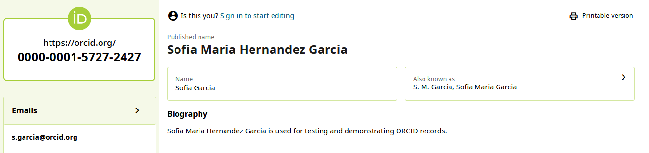
ORCID Record for Sofia Garcia
Notes:
In this example, we are looking at an ORCID iD for one of the Sofia Garcia’s that we saw earlier. While Sofia may have the same name as others, her ORCID iD is a completely unique 16 digit number that looks like a URL. You can also see that Sofia has used multiple different versions of her name, in the “Also known as” section.
Test record - https://orcid.org/0000-0001-5727-2427

Slide 9
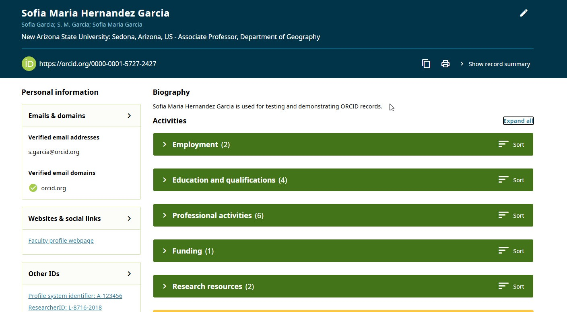
ORCID iD Record and Your Data
Notes:
What is included in an ORCID profile?
This is Dr. Garcia’s ORCID record. It contains several fields which can be customized at any time.
These fields include (along the left side):
Emails and Domains,
Websites and social links,
Other IDs, and
Countries.
You have the option to include a Biography, and information about your current and past employment, education, qualifications, professional memberships and service
The ORCID record is always evolving, so look out for additional fields to be added in the future.

Slide 10
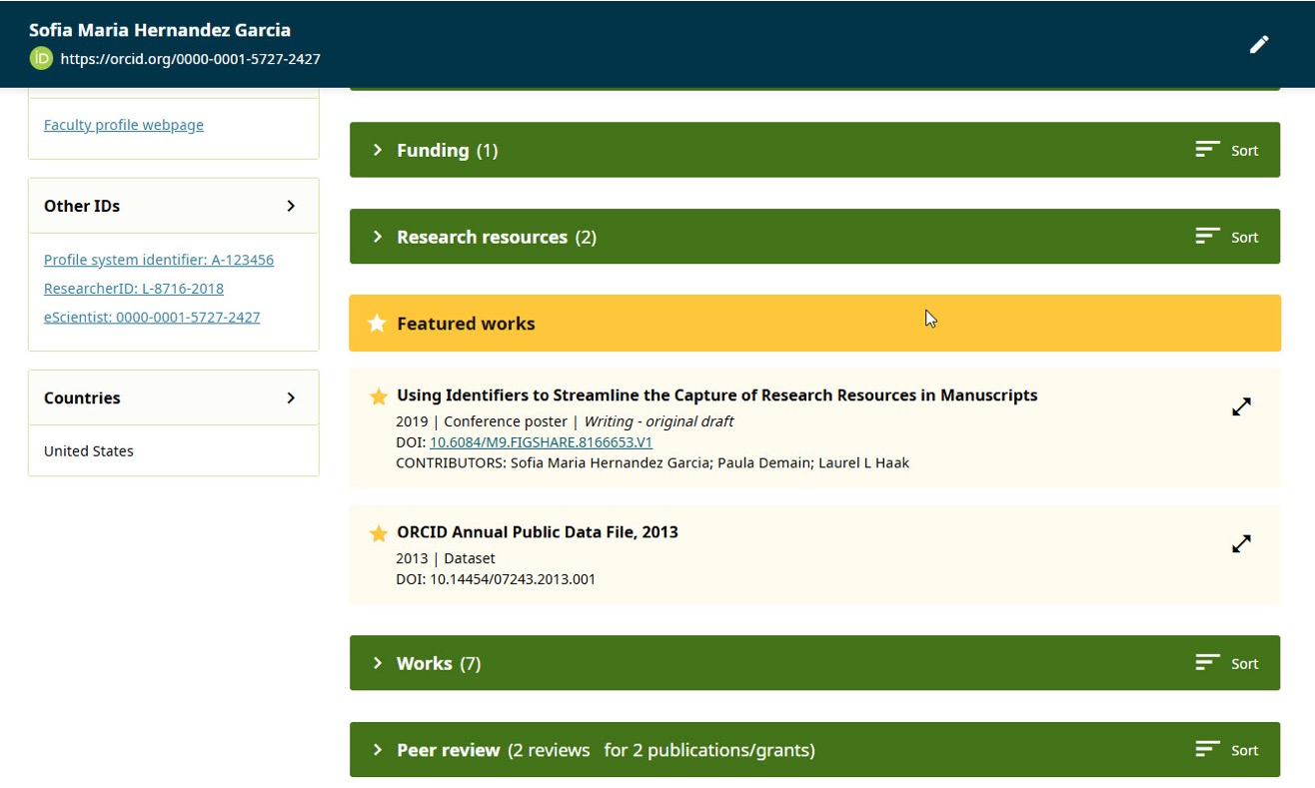
ORCID iD Record & Your Data
Notes:
This is the remainder of Dr. Garcia’s ORCID Profile
You have the option to include any grant funding you have received, works you have produced, and potentially any peer review activity you have been involved in.
The ORCID record is always evolving, so look out for additional fields to be added in the future.

Slide 11
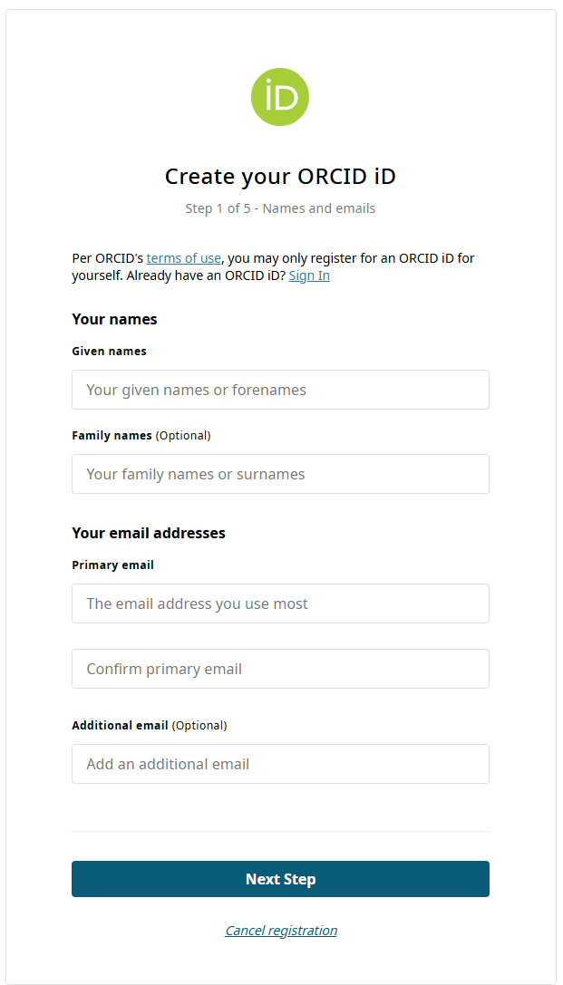
To get an ORCID iD, go to:
http://orcid.org/register
Notes:
It only takes about 30 seconds to register for your ORCID iD.
In the registration form, you just need to fill out your first and last name, primary email address, additional email address, and a password.
In the second step, you will select your notification settings - ORCID will send you notifications if one of your trusted parties makes a change to your ORCID data, such as adding a publication to your ORCID record.
Finally, you will set your default visibility settings, agree to ORCID’s terms of use, and confirm that you are not a robot. Once you click “register,” ORCID will send you an email to verify your account. You must verify your account before you can start adding data to your ORCID record.

Slide 12
Customizing Your ORCID Profile

Slide 13
Recommended ORCID record basics
Name(s)
Most recent employer
Most recent education information
Most recent works
Remember:
The more information in your ORCID record, the better it will work for you!
Notes:
At the most basic level, it’s recommended that you at least fill out your name and any names you have used over the course of your career, as well as your most recent employment, education, and works information. It should take about 10 minutes to add this initial information to your ORCID record. You can always go back and add more later.

Slide 14
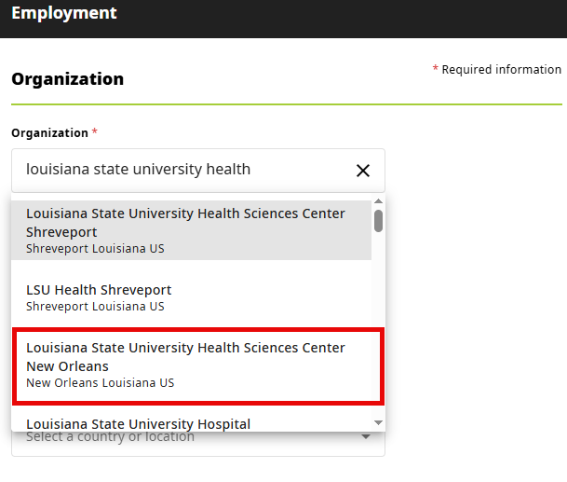
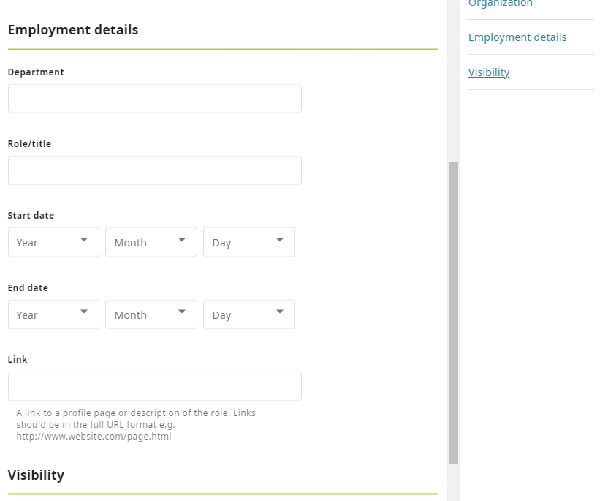
Add affiliations to your ORCID iD record
Start typing, and use the drop-down whenever possible.
Type Louisiana State University Health Sciences Center to locate our institution. We are NOT listed as LSU Health New Orleans.
Notes:
When adding Employment and Education affiliations, start typing the name of the organization and you will see a drop-down menu appear with a list of institution names. If possible, use the dropdown to select the institution name for your record and select the top-level organization name. This will ensure that your affiliated institution names will appear in a standard format with no typos, and the institutional identifiers will appear on your ORCID record.
Then you can add as many details such as dates of employment, department and title. You can also set the visibility for each affiliation.
NOTE: Our institution is listed as Louisiana State University Health Sciences Center New Orleans
See instructions for adding education: https://support.orcid.org/hc/en-us/articles/360006973933-Add-an-education-or-qualification-to-your-ORCID-record
See instructions for adding employment: https://support.orcid.org/hc/en-us/articles/360006894834-Add-employment-information-to-your-ORCID-record

Slide 15
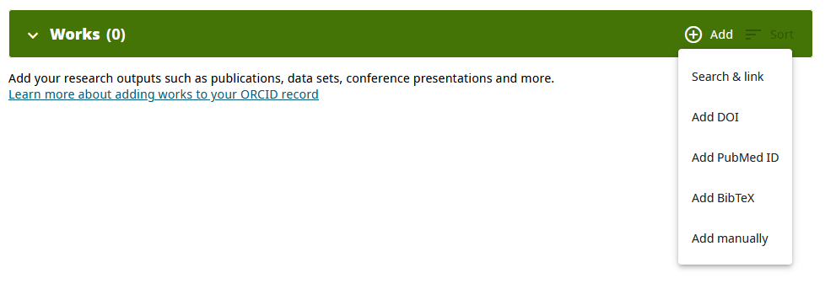
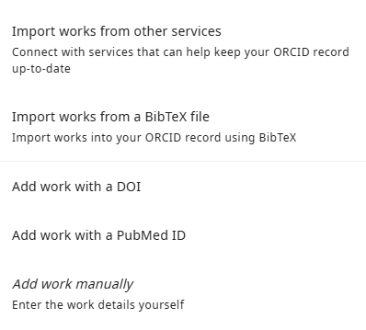
Add Works to your ORCID iD record
Save time by using the Import tools!
Notes:
Once you have your ORCID iD and are signed in, then you can start to add publications and other works including publications, data sets, conference presentations, and more.
Maximum number is 10,000 items.
Start by clicking on +Add on the header of the Works section.
There are 5 options for adding works. There are two options for adding multiple works at once:
Import Works from other services (this is the recommended method): Use this to connect to Web of Science or Crossref or other supported databases. You will authorize the platform as a Trusted Organization. This method ensures the data connected with your ORCID iD is authoritative and trustworthy and will save you time. The organization that added each work will be identified on the record.
Import Works from a BibTex file: This allows you to import publication that you have exported from Google Scholar or other systems in BibTex format. This method isn’t as robust as the import method because BibTex files are not standardized. This may lead to encoding issues and errors in your record.
There are three options for adding individual works:
Add work with a DOI: Enter the DOI and it will pre-populate the fields. Manually review to ensure the information is correct.
Add work with a PubMed ID: Same procedure as DOI
Add work manually: If the work doesn’t have a DOI or PMID, then add it manually.
When using any of these methods, your name will appear as the source of the record information.
Note: The more complete your ORCID record is, the better it will work for you.

Slide 16
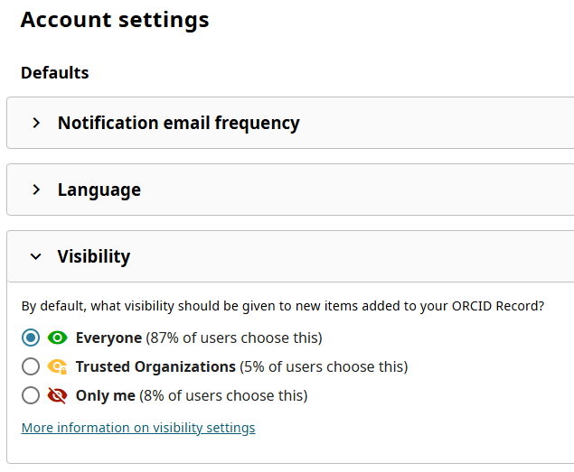
ORCID Visibility Settings – Entire Record
Settings for entire profile:
Notes:
You have control over how much of your ORCID record is visible to others.
The options for visibility are everyone, trusted parties, and only me.
You can control the visibility settings for your entire ORCID profile by clicking on the account setting under your name at the top right corner area of the ORCID record page. Then, clicking on visibility settings.

Slide 17
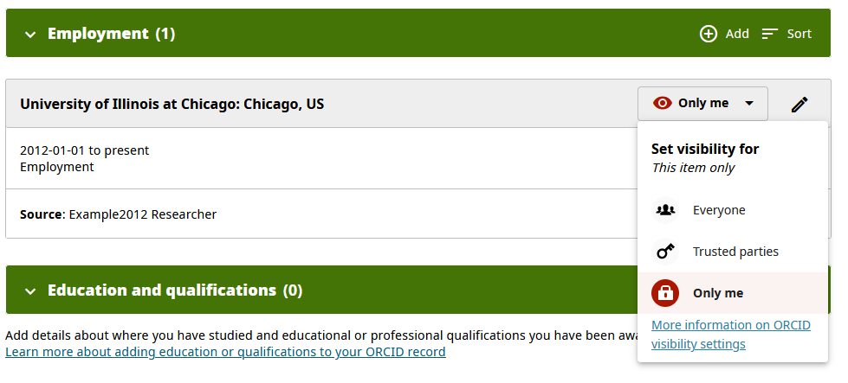
ORCID Visibility Settings – Individual Entries
Notes:
You can also control the visibility settings of each of the individual entries in your ORCID record.
Data in your ORCID record set to “trusted parties” is only visible by organizations and individuals that you have authorized as trusted parties in ORCID such as when submitting a manuscript or grant application. Access for each organization can be revoked at any time.
On the flip side, data in ORCID can be set to “only me,” which means that the only person who will ever see this data is you, as the individual.
ORCID respects your privacy and you have full control over your data.

Slide 18
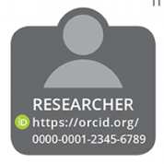


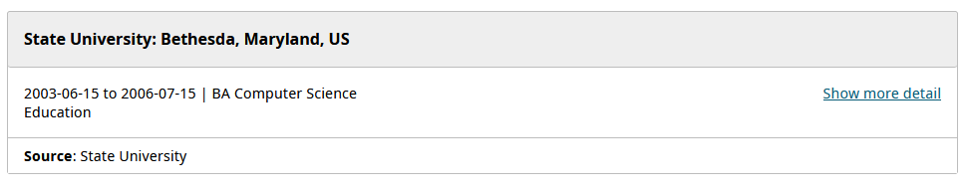
Trusted Organizations
Universities
Publishers
Grant funders
(ORCID-integrated system)
(Your ORCID iD)
Notes:
Trusted organizations are typically research institutions, publishers, or funding agencies that have integrated ORCID with their systems. It’s a good idea to connect your ORCID with as many of your affiliated organizations as possible, because you can often save time by letting these organizations add information to your ORCID record for you! Connecting with trusted organizations increases the chances that your contributions and works will be linked to you, recognized, and credited.

Slide 19




Recommended Trusted Organizations
Notes:
ORCID strongly recommends adding Crossref, DataCite, Elsevier Scopus, Clarivate Web of Science for seamless entry of new works and DimensionsWizard as source for adding funding organization info.

Slide 20
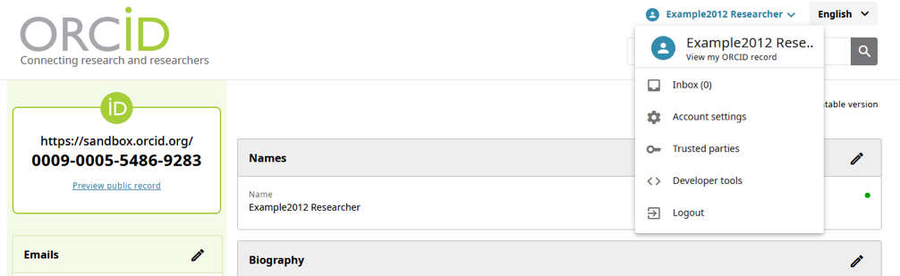
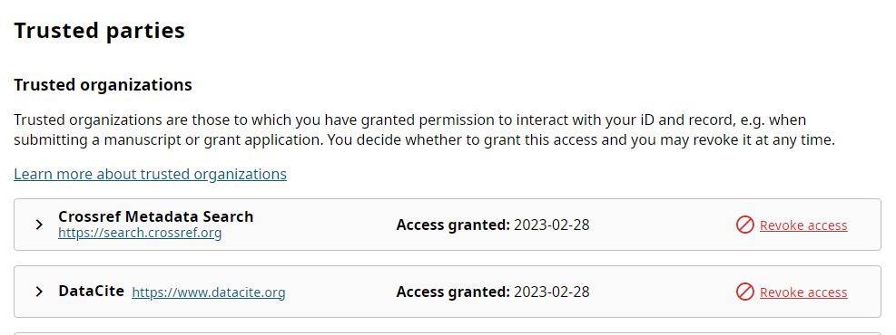
Trusted Organizations – How to Select
Notes:
To authorize an organization as a trusted party, the organization must ask you for permission to connect with your ORCID iD. When you go to interact with a system that is integrated with ORCID, you will be prompted to authorize permission for the institution to connect with your ORCID iD and record.
Once you connect your ORCID iD with an organization, you can see those organizations appear in the account settings page of your ORCID record under “Trusted Parties.” You will see your trusted organizations listed, with the name of the organization or platform, the date you connected your ORCID iD, and the permissions that you granted to each organization to interact with the information in your ORCID record.
You may revoke access at any time.

Slide 21
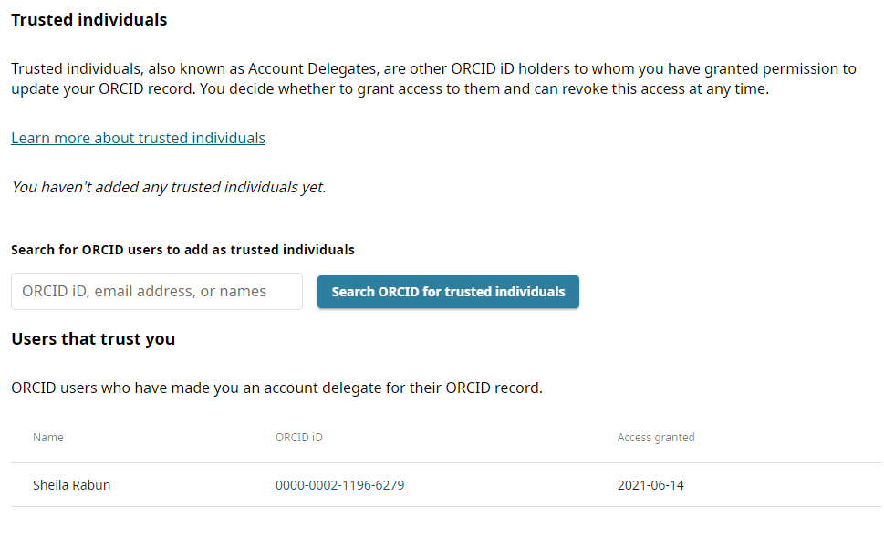
Trusted Individuals
Trusted Individuals = People who also have an ORCID iD, that you can designate to have access to edit your ORCID record for you.
Notes:
In the same “Trusted Parties” page in your ORCID record, you can also designate individuals as trusted parties by searching for a trusted person’s ORCID iD, email address, or name. Whomever you authorize as a trusted individual will be able to add data to your ORCID record, make changes, and see data set to “trusted parties” visibility.
This could be a business manager, an assistant, or someone else that you trust.

Slide 22
How ORCID Benefits Researchers
Distinguish yourself from other researchers
Manage your reputation and research impact
Get credit for your contributions, and affiliations
Save time on funding, publishing, & research reporting workflows
Notes:
As a researcher, once you have filled in your ORCID record and continue to authorize organizations as trusted parties connected to your ORCID record, you can use ORCID to distinguish yourself from other researchers, manage your reputation and research impact, get credit for your research, contributions, and affiliations, and save time on data entry for funding, publishing, and research reporting workflows.

Slide 23
Connecting Your ORCID

Slide 24
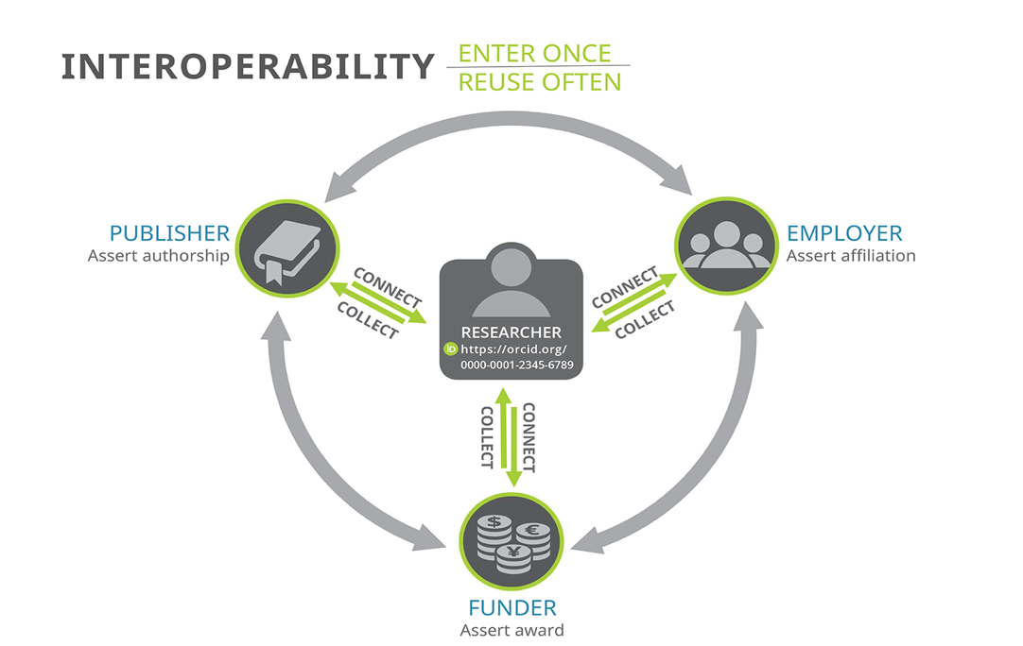
ORCID is used by publishers, funders, & institutions
Notes:
ORCID is used by major research institutions, publishers, and funders across the globe.
Over 70 publishers are now requiring ORCID iDs with manuscript submissions, and grant funders are increasingly requiring ORCID iDs for grant proposals as well. By including your ORCID iD in publishing and funding workflows, you can ensure that your work and contributions will be accurately linked to you, and not accidentally credited to someone else. Research institutions across the globe are also increasingly using ORCID.

Slide 25
History of the ORCID Number in Federal Science Policy
NIH announces requirement for ORCID use by trainees
Grants in the trainee, fellowship, and “K” career series are affected. Also includes AHRQ and CDC.
NSPM-33 mentions Digital Persistent Identifiers
WIde-reaching federal STEM security policy includes persistent identifiers as part of identity management
NIH warns of forthcoming ORCID and SciENcv requirements
Despite this long warning, implementation is still a mess
2020
2023
2025-2026
2019
2021
2024
NIH trainees start having to use ORCIDs
eRA Commons allows personnel to link ORCIDs
PIs and personnel start noticing ORCIDs more, which raises awareness of them in the grant context. Reinvigorates discussing value of ORCIDs for following graduate student outcomes post-graduation.
NSF starts requiring ORCIDs
Research.gov and NSF SciENcv biosketches in the “common forms” format must include ORCID
NIH issues requirement for ORCID in eRA Commons and SciENcv
Requirement for ORCID identifier to be entered in eRA Commons and in SciENcv biographical sketch for “common forms” format came into effect January 2026, then went into leniency until May 25, 2026
Notes:
[read title card]
Since 2019, Federal organizations have required ORCID use in come capacity. In 2019, the NIH required certain grant recipients to include ORCIDs.
In 2020 that expanded and began to include eRA Commons.
2021 had an executive order that included PIDs as necessary identification of researchers.
National Security Presidential Memorandum – 33; issued1/14/2021
https://trumpwhitehouse.archives.gov/presidential-actions/presidential-memorandum-united-states-government-supported-research-development-national-security-policy/
In 2023 the NSF began mandating ORCID use and in 2024 the NIH ‘warned’ that it would also mandate ORCID use for SciENcv.
Now in 2026, the NIH requires ORCID use for eRA Commons and SciENcv, which goes into effect next Monday, May 25th.
NOT-OD-26-018 - NIH’s Implementation of Common Forms for Biographical Sketch and Current and Pending (Other) Support for Due Dates on or after January 25, 2026
https://grants.nih.gov/grants/guide/notice-files/NOT-OD-26-018.html
NIH/CDC/AHRQ - Notice Number: NOT-OD-19-109 - Requirement for ORCID iDs for Individuals Supported by Research Training, Fellowship, Research Education, and Career Development Awards Beginning in FY 2020
https://grants.nih.gov/grants/guide/notice-files/NOT-OD-19-109.html
Funders use ORCID iDs to make funding applications and outcome reporting easier, to improve the reusability of the information they collect, to ensure the accurate citation of an award (by pushing award information into ORCID records), and to recognize the contributions of reviewers. https://info.orcid.org/funders-orcid-policies/

Slide 26
Links to ORCID Funder Requirements
Other funders require ORCID iDs as well and have issued a policy or statement relating to their use of ORCID iDs.
  See List: Funders' ORCID policies - ORCID
Notes:
Funders use ORCID iDs to make funding applications and outcome reporting easier, to improve the reusability of the information they collect, to ensure the accurate citation of an award (by pushing award information into ORCID records), and to recognize the contributions of reviewers. https://info.orcid.org/funders-orcid-policies/

Slide 27
NIH Systems and ORCID
IMPORTANT NOTE:
The same ORCID number must be linked in both eRA Commons and sciENcv/myNCBI!
sciENcv
Based on the My NCBI platform
Where researchers manage their biographical sketches (ie Biosketches)
eRA Commons
Where researchers manage their NIH user information
Only the individual has access/control of this platform

Slide 28
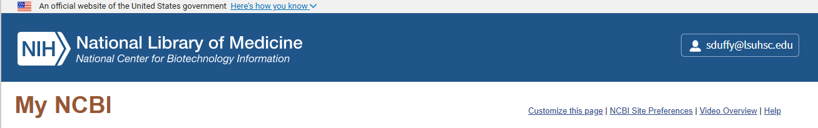
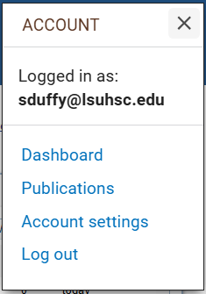
My NCBI and ORCID
You are going to need to add ORCID as a Linked Account in the My NCBI platform.
The URL to this login page is https://www.ncbi.nlm.nih.gov/account/
Notes:
[read title]
When you log into My NCBI, you can link your ORCID by selecting your name in the top right corner and selecting ‘Account Settings.’

Slide 29
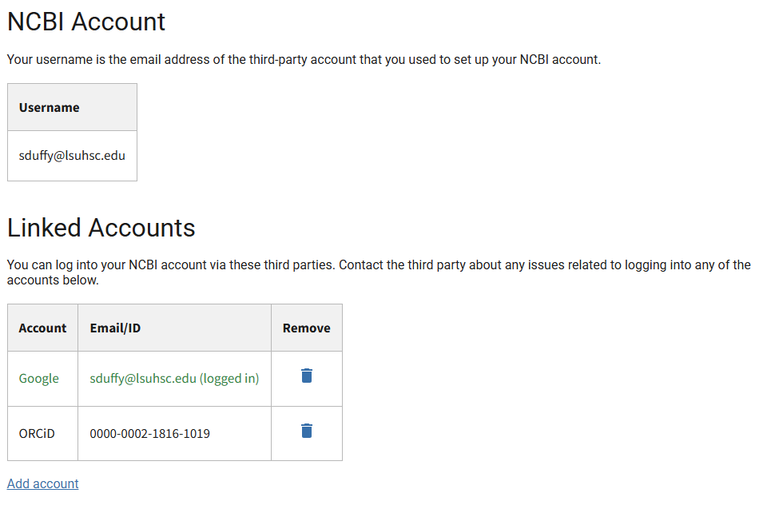
My NCBI and ORCID – Linking
Notes:
You will then go down the page until you see ‘Linked Accounts’ and you will select ‘Add Accounts’. You will see a popup asking you to login to your ORCID, and your accounts will not be linked to each other. Early career researchers/students who have not yet created a My NCBI account or ORCID can create an ORCID, and then create accounts across platforms, which automatically links your ORCID to each platform, so you can avoid this step from the beginning. Those with longstanding, separate accounts will have to follow these steps.

Slide 30
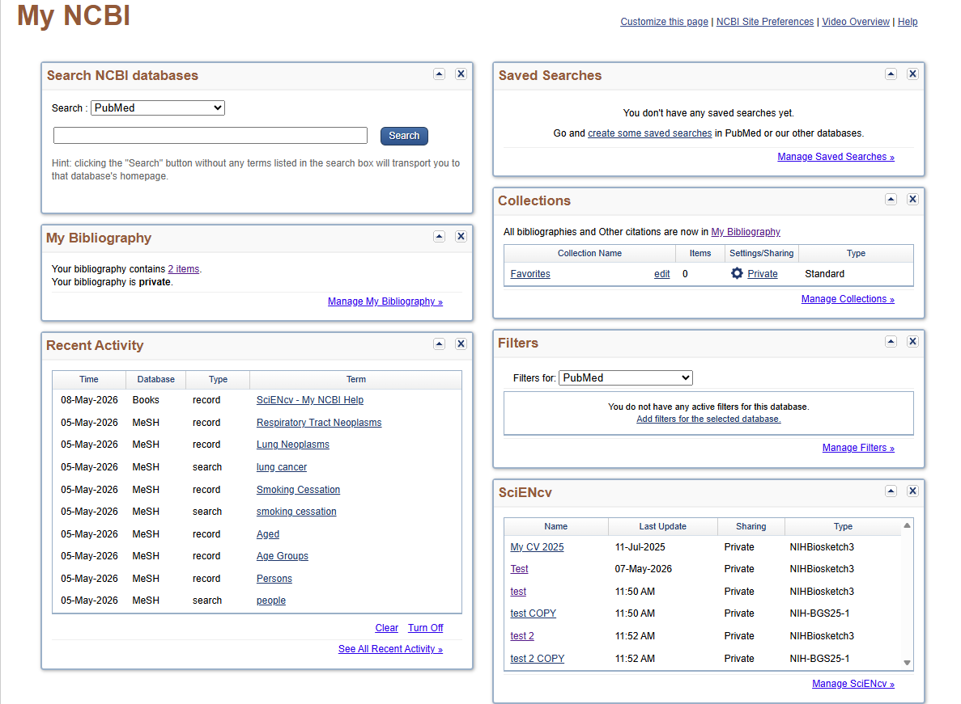
SciENcv and ORCID
Notes:
To access SciENcv, you will still be on your My NCBI account page, but will look to the bottom right corner where it says ‘manage SciENcv’. Select it and you will be brought to the page where you can begin the process.

Slide 31
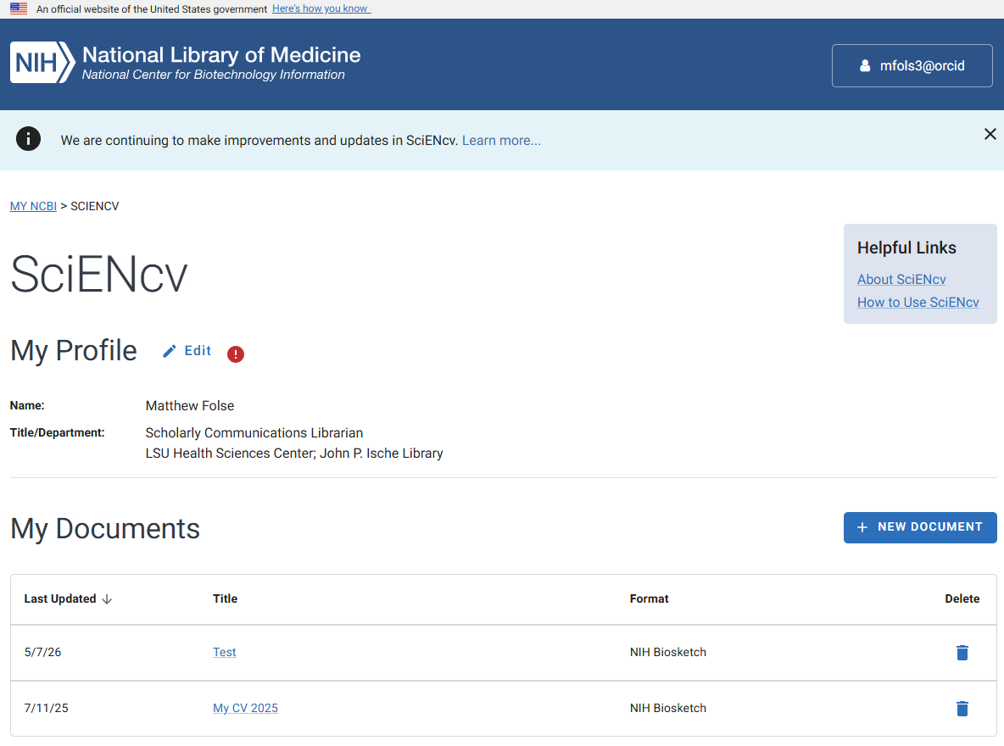
SciENcv & ORCID
Notes:
On this page, after you’ve linked your ORCID to your My NCBI, you will select ‘New Document.’

Slide 32
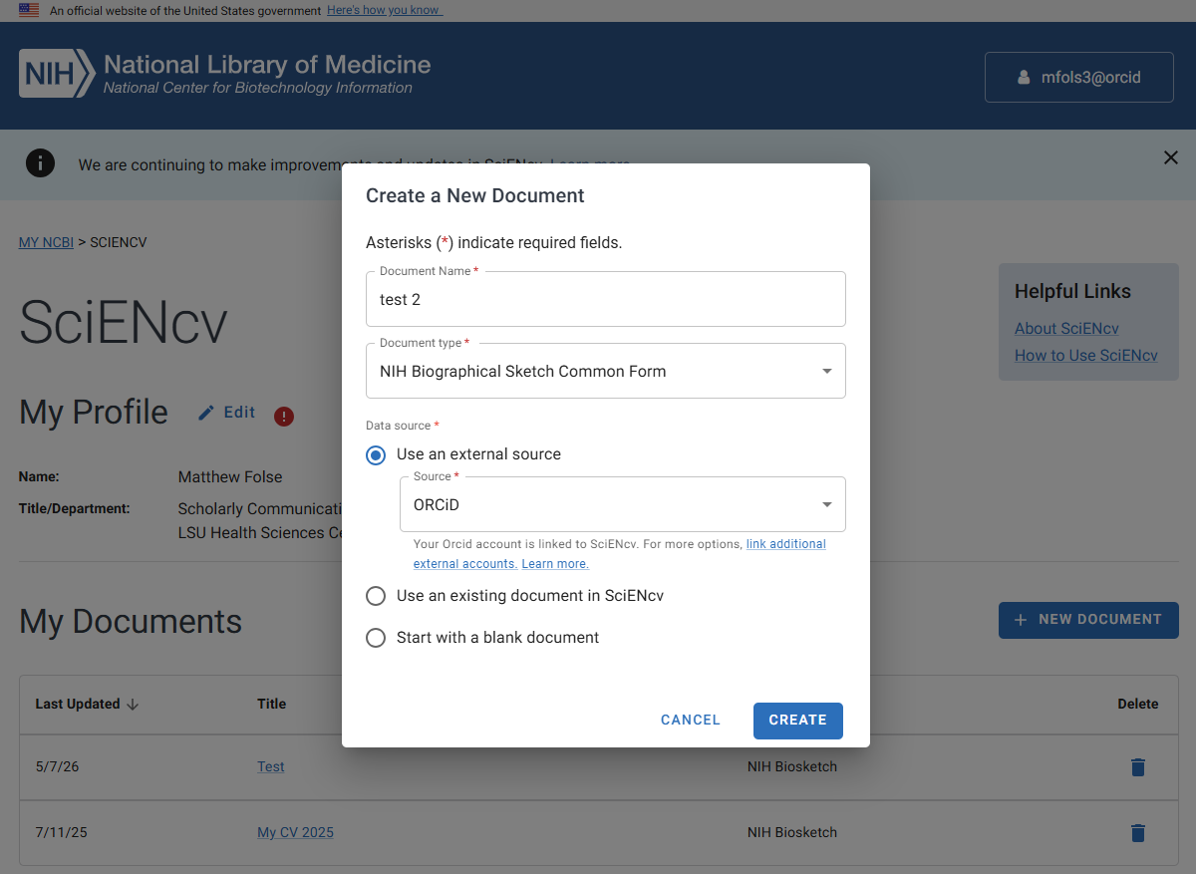
SciENcv and ORCID – Linking
Notes:
This popup will appear and you will enter a title, and select which form you want to use. Be sure to select ‘NIH Biographical Sketch Common Form’ and not any other, as it will not direct you to the correct form. Next you can select where to extract information from to the form, and you can select ORCID. This will automatically populate certain sections of the form itself.

Slide 33
SciENcv and ORCID and Common Form
What ORCID auto-fills in BioSketch Common Form
What ORCID does not auto-fill in Biosketch Common Form
Identifying Information, Organization and Location
Professional Preparation
Appointments and Positions
Products
Personal Statement
Honors
Contributions to Science
Notes:
Here’s a breakdown of what automatically populates the Common Form when you import from ORCID. It autofills Identifying Information, Organization, and Location. The Professional Prepration section, Appointments and Positions section, and the Products section. What isn’t automatically populated (if your ORCID is up to date), is the Personal Statement Section, the Honors section, and the Contributions to Science.

Slide 34
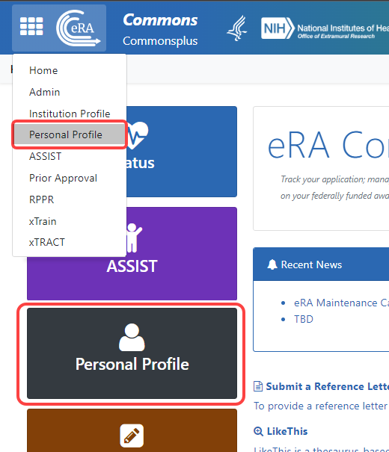
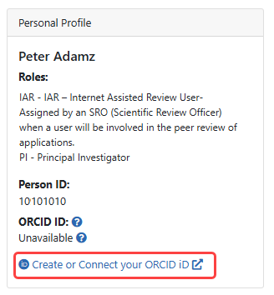
eRA Commons and ORCID
Notes:
I do not have access to eRA Commons, so this information comes from eRA Commons’ knowledge base/FAQ. When you log into the platform, you will select Personal Profile either from the dropdown menu on the left side or the box pictured on the left-hand screenshot. On that page will a link to ‘Create or Connect your ORCID’. The same as connecting your My NCBI, a popup will appear of ORCID asking you to create your account or login, and once you do so the accounts will be connected.

Slide 35
To get the most benefit from ORCID:
Step 1: REGISTER – Get your unique ORCID identifier
Step 2: ADD YOUR INFO – Populate your ORCID profile with your professional information and research outputs; Link to trusted organizations to automate the process
Step 3: USE YOUR ORCID ID – Include it when submitting manuscripts, applying for grants, presenting your work
Register Now: http://orcid.org/register
Note: Stop by the Library and pick up an ORCID iD sticker!
Notes:
To set up your own ORCID iD to your advantage, you will need to:
Register to get your own ORCID iD number
Add as much biographical information as you want to your ORCID record, keeping in mind that the more complete your ORCID record is, the better it will work for you
Connect with your affiliated organizations (if they have an ORCID integration) to authorize them as “trusted parties” (If your institution has an integration, see next slide. If not, go to point 4 below and skip the next slide)
4) Go to orcid.org/register now and register for your ORCID iD.

Slide 36
ORCID Resources
Library Resource Guide
ORCID.org
ORCID and eRA Commons help
ORCID and My NCBI/SciENcv help
Get help from a Librarian:
Office Hours Session: Wednesday May 27 at 12 – 2pm in Library or via Zoom
Email us or reference@lsuhsc.edu for details
Request an appointment: Fill out this Microsoft Form
Notes:
If you’re interested in assistance from the libraries, we have a resource guide, as well as will provide assistance with creating and supplementing your ORCID with your scholarly output and linking it to trusted parties. We will be having an additional office hours session Wednesday May 27th, at 12 noon until 2pm in the downtown library. Email the reference email shown here for additional details. If you want to request a 1 on 1 appointment, fill out the Microsoft Form and someone will be in touch.

Slide 37
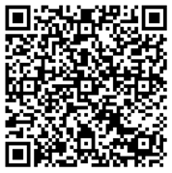

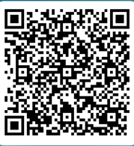
Questions?
Library Instagram
Request ORCID Assistance
Short Survey
Sharon Duffy
Research Services Librarian
School of Medicine Liaison
sduffy@lsuhsc.edu
Julie Schiavo
Assistant Director, Dental Services
School of Dentistry Liaison
jschia@lsuhsc.edu
Notes:
Thanks everyone for joining today’s presentation. Here are a few QR codes if you don’t mind scanning them. Please fill out a short survey about this class, follow the library Instagram for information on construction updates or reminders about free popcorn on Thursday, and the final QR code will redirect you to the form to request ORCID assistance.

